Slide 1
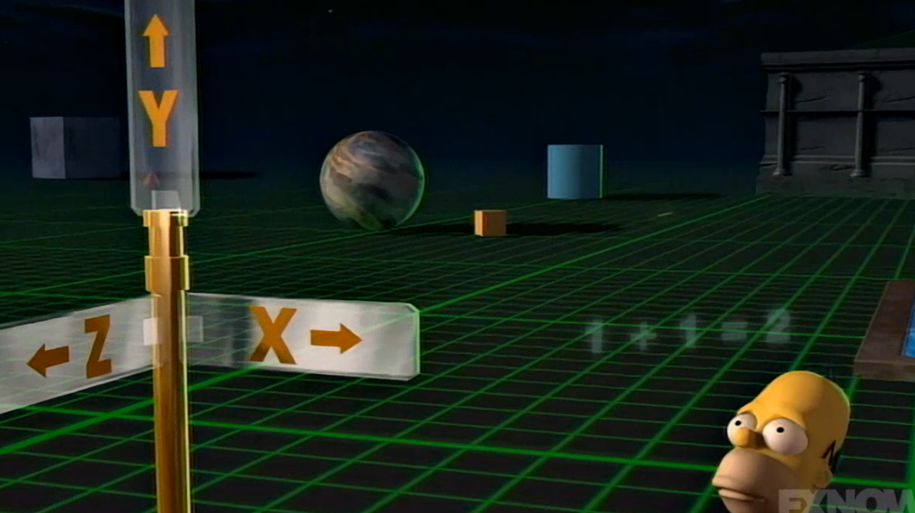
Adding a Dimension to React
August 26h 2021
React Three Fiber

Slide 2
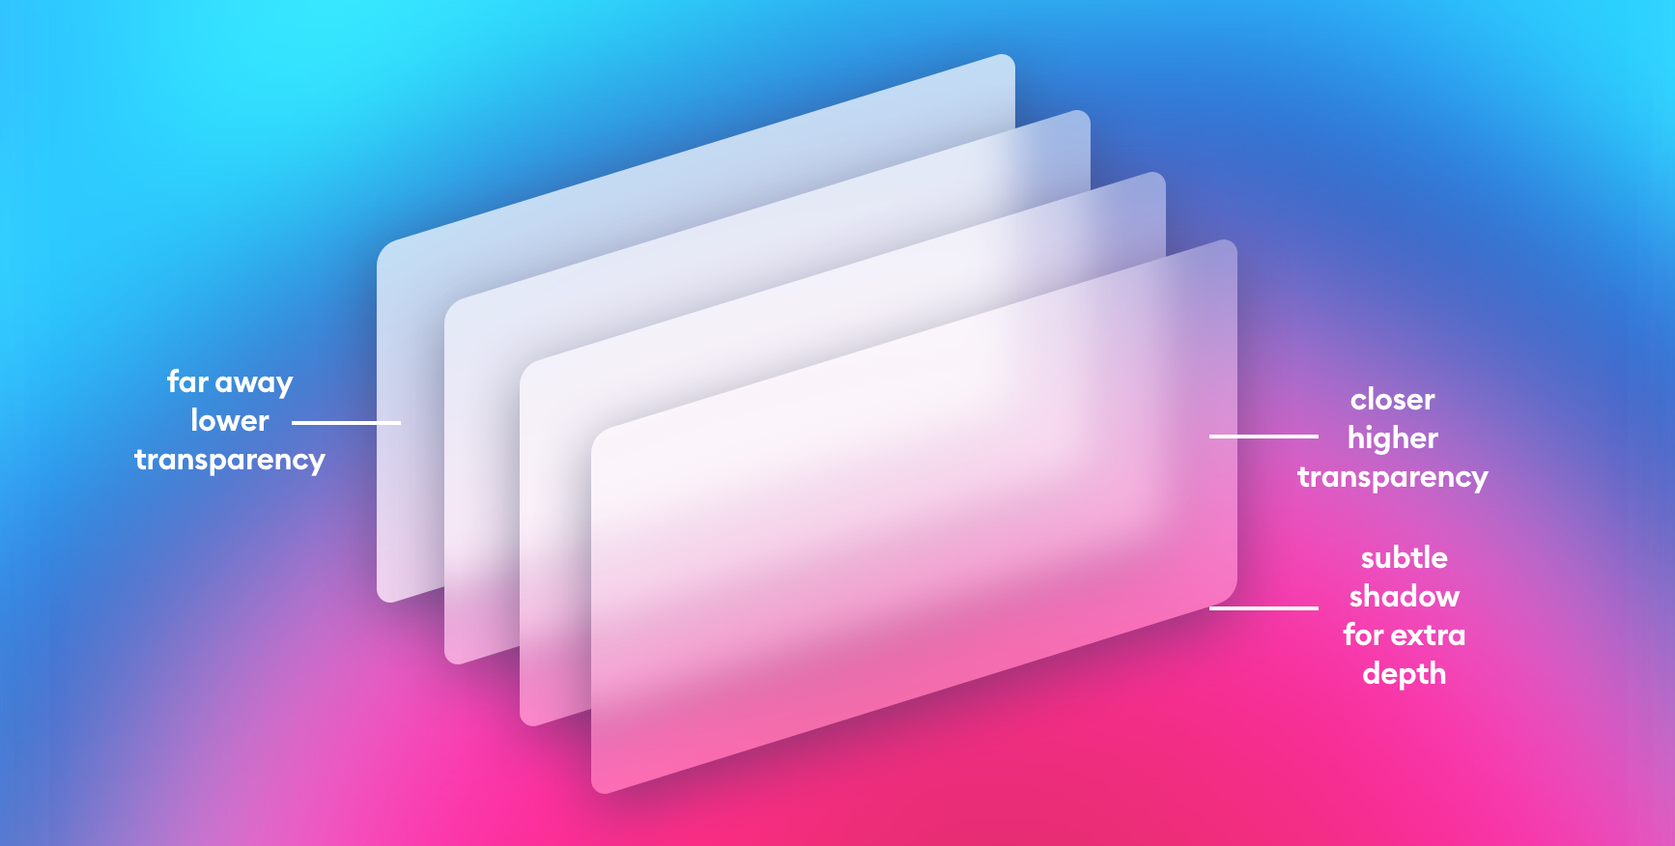
Stop trying to do 3D effects with CSS
A case study on how not to do it
My goal was to play create some glass morphism with some 3D effects.
With some cool background effect – Animated SVG
3D scroll effect
The result was ultra-low FPS and me losing interest in project :)
Blur effects are to CPU expensive
Rendering errors
There is an easier solutions out there to do cool effects

Slide 3
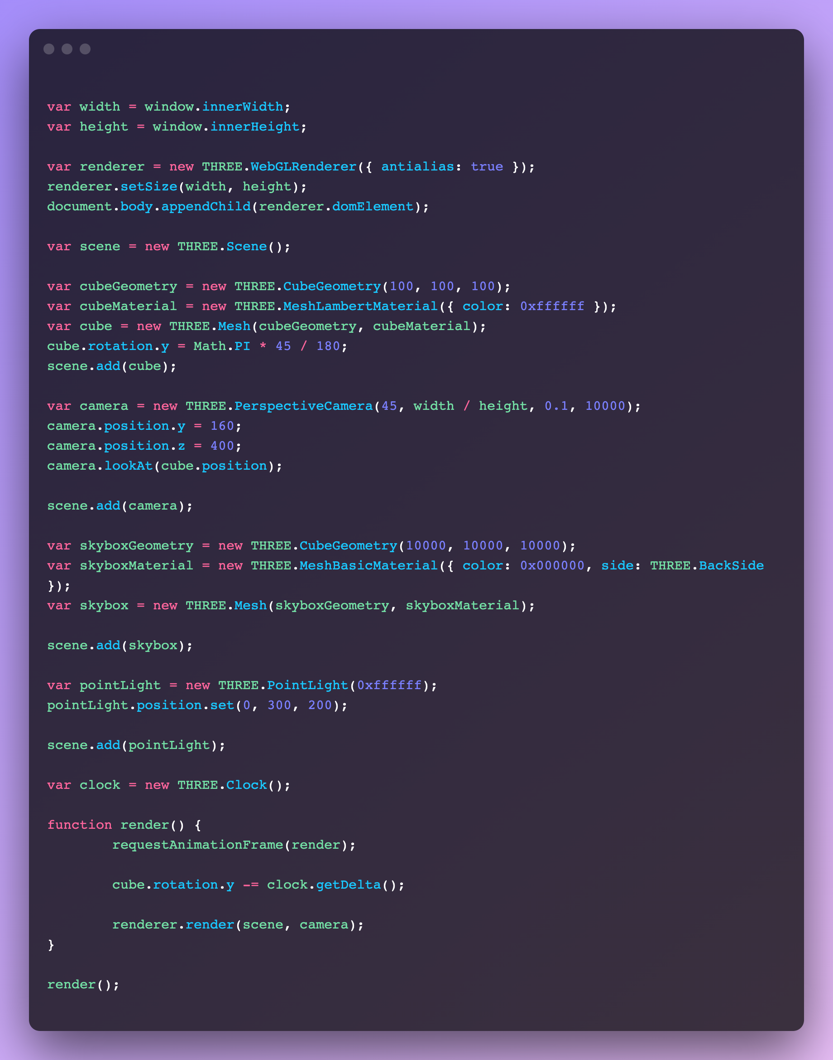

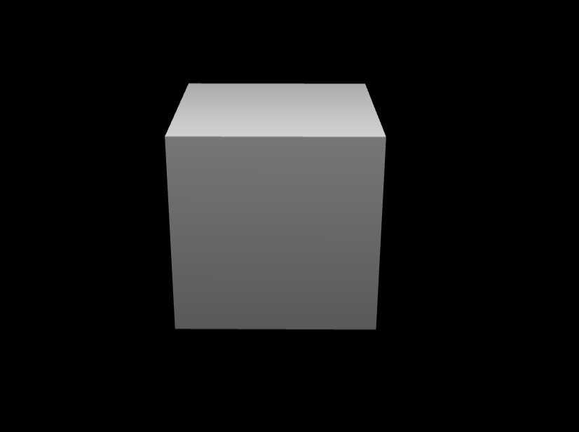
Three.js to the rescue
A WebGL library created by Ricardo Cabello in 2010 and have 1300 contributors on GitHub
=
=
https://codepen.io/chadritchie/pen/ykciH?editors=0010

Slide 4
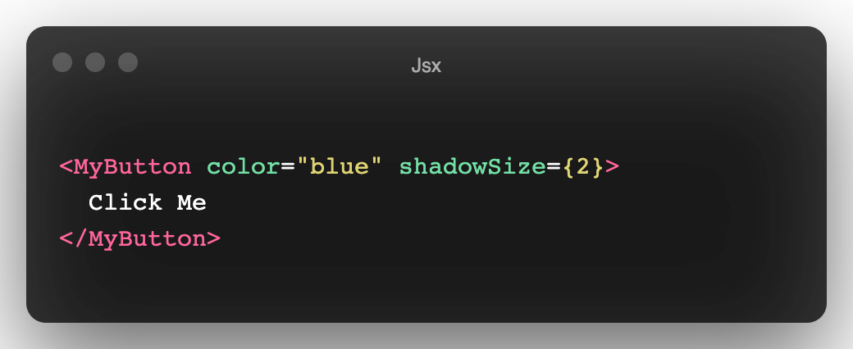
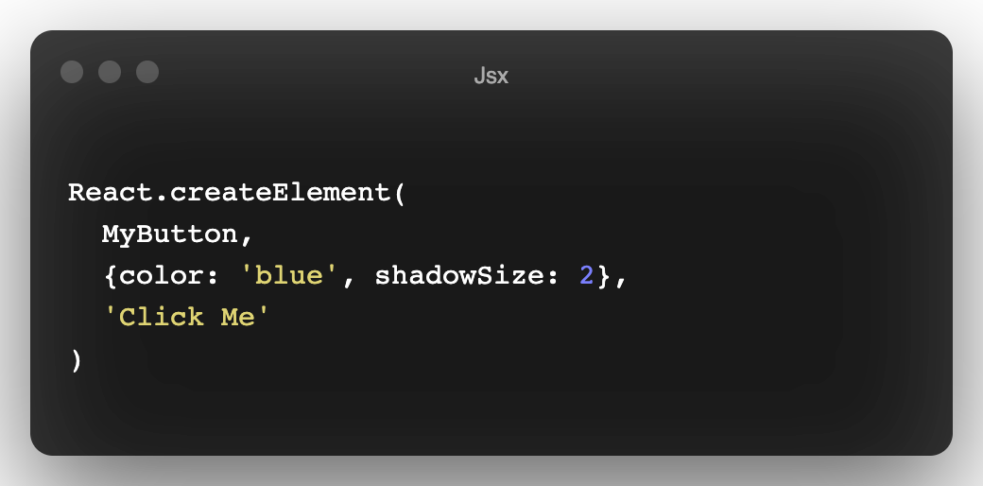
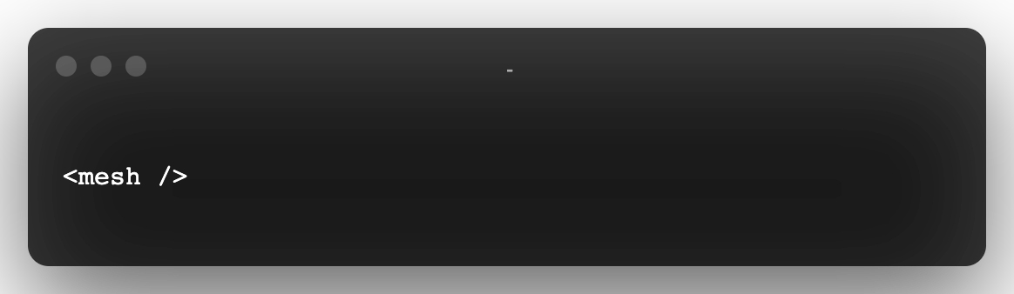
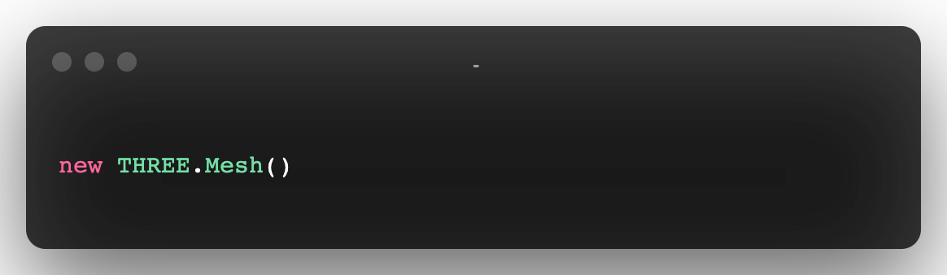
What does this have to do with React.js?
React is handling the component tree and we have different renders like ReactDom and React-Native
Now we have a new render called React-Three-Fiber and it is converts a React tree into underlying three.js calls. Just like we have in React Jsx
React-Three-Fiber does the same but generates three.js primitives instead

Slide 5
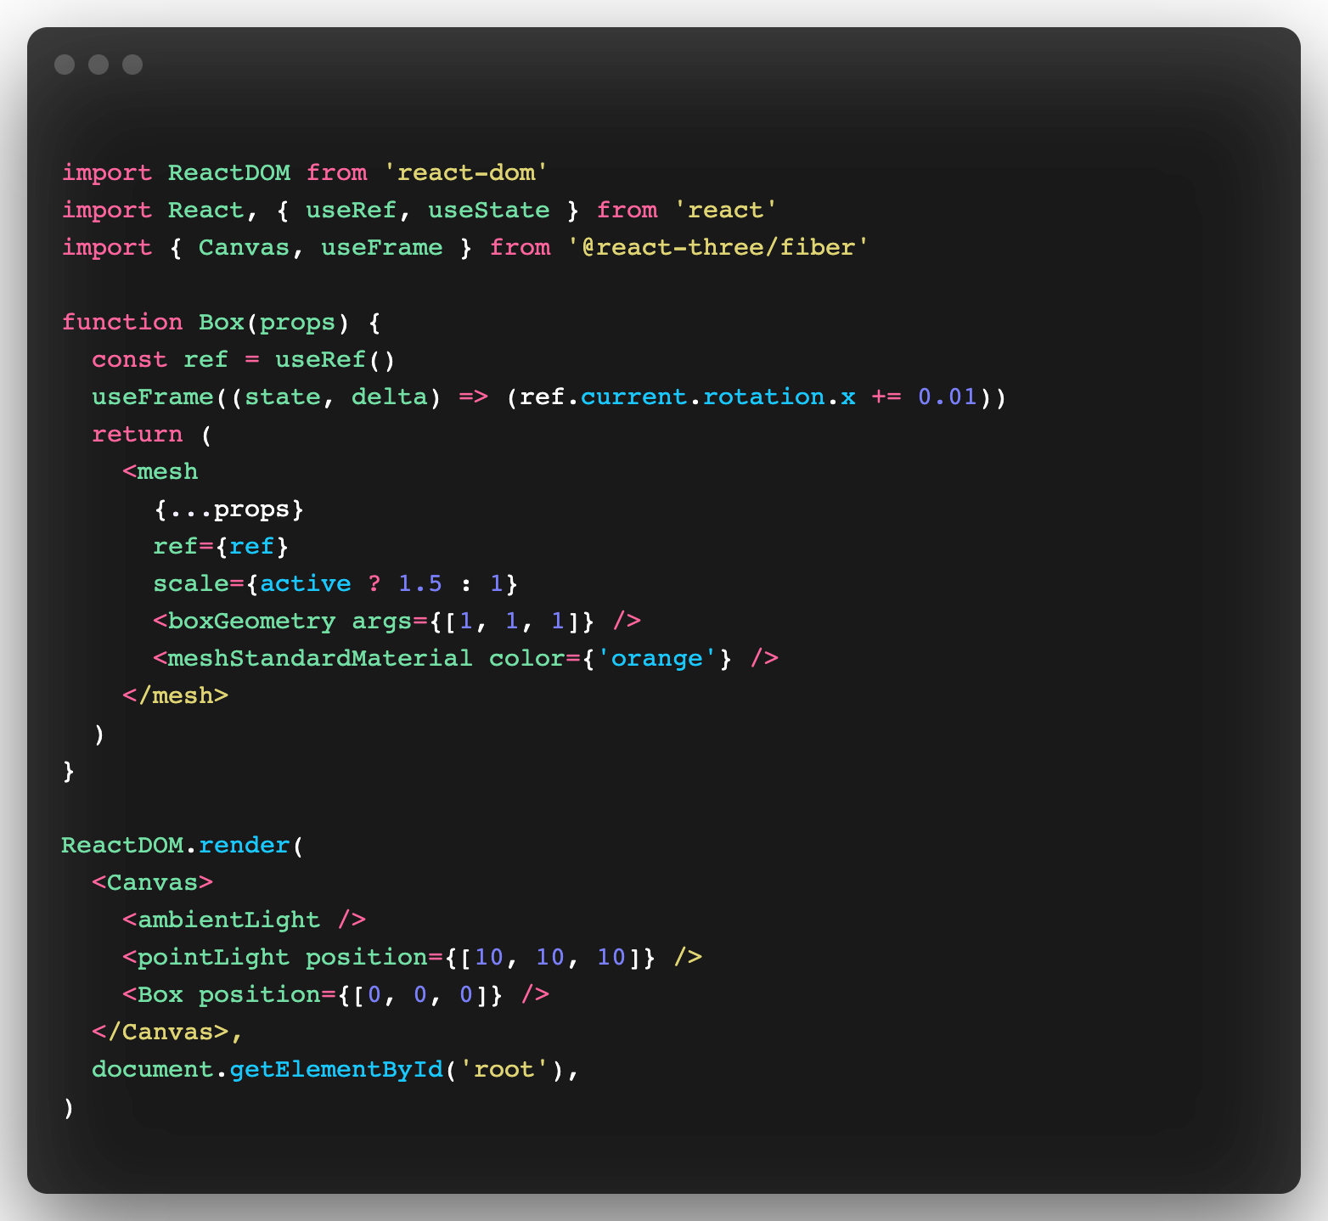

React Three Fiber
Now let’s us create the same box writen in React.Js with React-three-fiber
=
=

Slide 6
DEMO

Slide 7
More information on React-Three-Fiber
Package to checkout:
@react-three/gltfjsx – turns GLTFs into JSX components
@react-three/drei – useful helpers for react-three-fiber
@react-three/postprocessing – post-processing effects
@react-three/flex – flexbox for react-three-fiber
@react-three/xr – VR/AR controllers and events
@react-three/cannon – physics based hooks
zustand – state management
react-spring – a spring-physics-based animation library
react-use-gesture – mouse/touch gestures
leva – create GUI controls in seconds
Demo repo: https://github.com/vLX42/react-three-fiber-demo
Demo link: https://react-three-fiber-demo.vercel.app/

